Slide 1
High Level Design (HLD) - Mini SOC Platform
Presented by: Azeddine Hamdaoui

Slide 2
Overview
This document describes the high-level design for the Mini SOC (Security Operations Center) platform using Wazuh SIEM (Security Information and Event Management), docker swarm (container orchestration), and DevOps practices.

Slide 3
Scope
Deployment of Wazuh stack on Docker Swarm
high availability (HA), disaster recovery (DR), fault tolerance, and scalability

Slide 4
Wazuh SIEM Overview

Slide 5
What is Wazuh?
Wazuh is an open-source security platform that provides log analysis, intrusion detection, vulnerability detection, and compliance monitoring.
It acts as a Security Information and Event Management (SIEM) system, collecting and analyzing data from endpoints, servers, and network devices

Slide 6
Key Components
Wazuh Manager: Central component that analyzes security events, generates alerts, and manages agents.
Wazuh Agents: Installed on endpoints or servers to collect logs, monitor files, detect anomalies, and send data to the manager.
Elasticsearch / Indexer: Stores and indexes the collected data for fast search and analytics.
Kibana: Provides dashboards and visualizations for monitoring and reporting.
Filebeat / Log Shippers: Forward logs from agents to Elasticsearch in real time.

Slide 7
Wazuh stack Architecture Diagram

Slide 8
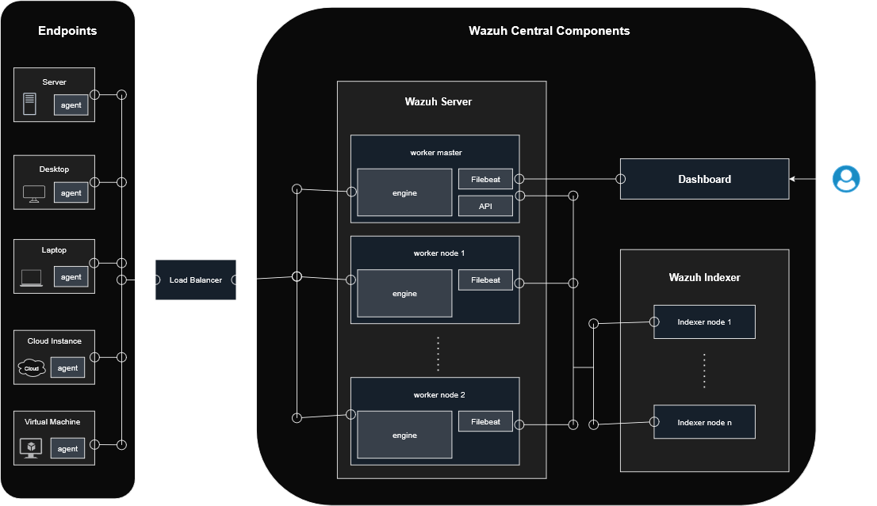

Slide 9
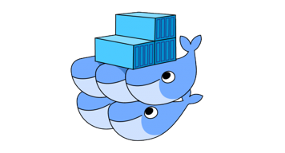
Container Orchestration with Docker Swarm

Slide 10
Docker Swarm Overview
Container orchestration tool built into Docker
Enables you to manage multiple containers across different hosts as a single cluster.
Unlike standalone Docker, Swarm automates deployment, scaling, and container lifecycle management.
Manages clusters of Docker nodes (machines) as a single virtual system
Nodes (physical or virtual machines) are grouped under one “swarm,” appearing as one logical Docker host.
This allows distributed workloads to be managed from a single control point.
Provides high availability, scalability, and load balancing
Swarm automatically replicates services across nodes to prevent downtime.
Traffic is distributed evenly between containers using built-in load balancing.
You can easily scale services up or down with one command (docker service scale).
Secure and integrated by design
Uses mutual TLS for secure node communication.
Works natively with existing Docker CLI and Compose files, requiring minimal new tooling.

Slide 11
⚙️ How It Works
Manager Nodes: Control the cluster, schedule services, handle orchestration.
Worker Nodes: Run the containers (services) assigned by the managers.
Overlay Networks: Enable container communication across multiple hosts.
Service Replication: Automatically restarts failed containers.

Slide 12
Why Use Docker Swarm in This Project
Simplifies multi-container deployment (e.g., Wazuh stack).
Ensures high availability for critical services.
Seamlessly scales horizontally when load increases.
Built-in integration with Docker CLI (no external setup like Kubernetes).

Slide 13
Wazuh Stack Architecture on Docker Swarm
(3-Node Cluster)

Slide 14
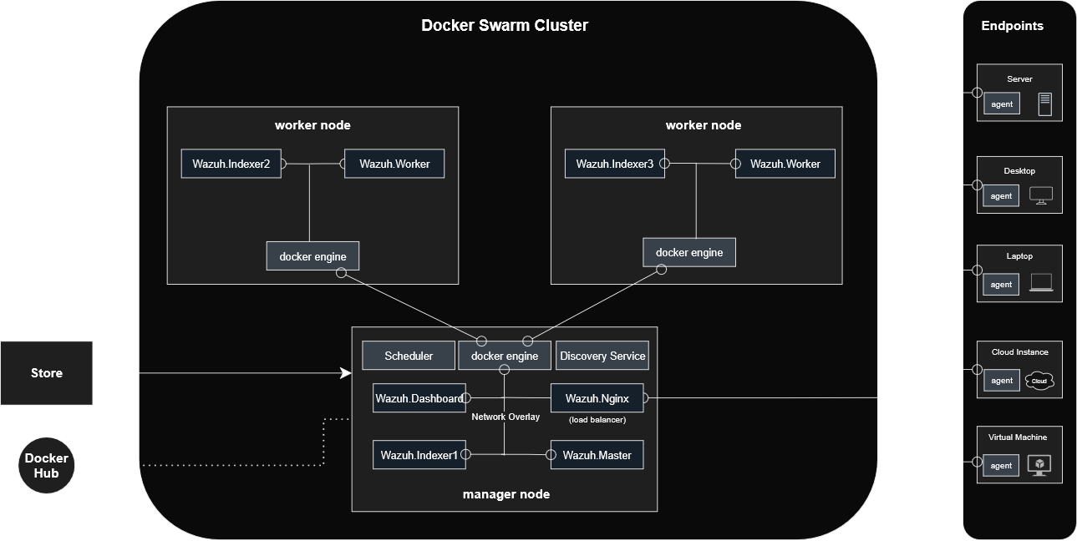

Slide 15
High Availability (HA), Disaster Recovery (DR), Fault Tolerance & Scalability
Ensuring continuous operation and resilience of the Wazuh Stack on Docker Swarm.

Slide 16
Introduction
Why Reliability Matters
Security platforms must operate 24 / 7 / 365.
Outages or data loss reduce visibility and response capability.
This section covers the design strategies that make the environment resilient, recoverable, and scalable.

Slide 17
High Availability (HA)
Definition:
Ability of the system to remain operational despite node or service failures.
Implementation:
Multiple Swarm nodes (1 manager + 2 workers) for cluster redundancy.
Wazuh Indexer replicated across nodes for continuous log indexing.
Wazuh Nginx acts as a load balancer for dashboard/API traffic.
Overlay networks ensure service communication even if one node fails.

Slide 18
Disaster Recovery (DR)
Definition:
Process for restoring services and data after a catastrophic event.
Implementation:
Automated backups of Indexer data and configurations.
Off-site or remote storage of backups (e.g., S3 / NAS / remote volume).
Recovery scripts or CI/CD jobs to redeploy Swarm stacks quickly.
Option for secondary Swarm cluster or DR site replication.

Slide 19
Fault Tolerance
Definition:
Capability to continue operation when individual components fail.
Implementation:
Swarm service replication keeps containers running if one crashes.
Health-check & restart policies automatically recover failing services.
Decoupled services (Manager, Indexer, Dashboard) prevent cascade failure.
Persistent volumes protect stored data during container restarts.

Slide 20
Scalability
Definition: Ability to increase capacity or performance as demand grows.
Implementation:
Horizontal scaling: add worker nodes to the Swarm cluster.
Vertical scaling: allocate more CPU/RAM to existing nodes.
Dynamic scaling via CI/CD: pipelines deploy additional replicas automatically.
Load balancing distributes traffic among Indexer and Worker nodes.

